Slide 1
Northeast Underwater Research, Technology and Education Center (NURTEC)
Ivar G. Babb
“Establishing Community Standards for Underwater Video Acquisition, Tagging, Archiving, and Access “ Community Workshop
June 1-2, 2016, University of Rhode Island

Slide 2
Topics
Video Evolution & Archive
Formats, Formats & More Formats & Digitization
Metadata & Barcodes
Google Map Access
Current Video Workflow
Vehicles
Cameras
Timecode & Other Data
Encoders
Storage
Distribution

Slide 3
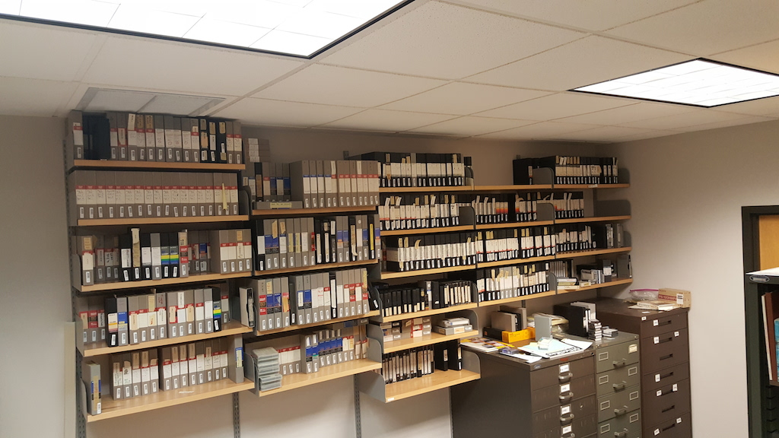
Video Formats – 1973 to 2002
Sony Helix Video Tape, ¾” UMatic, VHS, 8 mm, Hi-8 mm

Slide 4
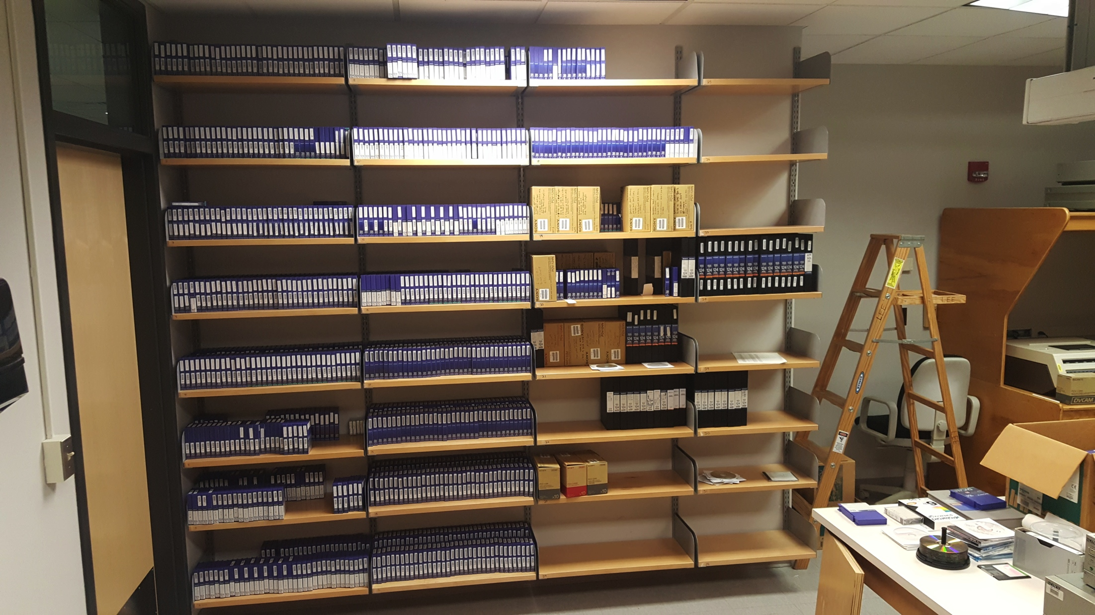
Video Formats – 2003 to 2010
DVCam, HDV, HDCam

Slide 5
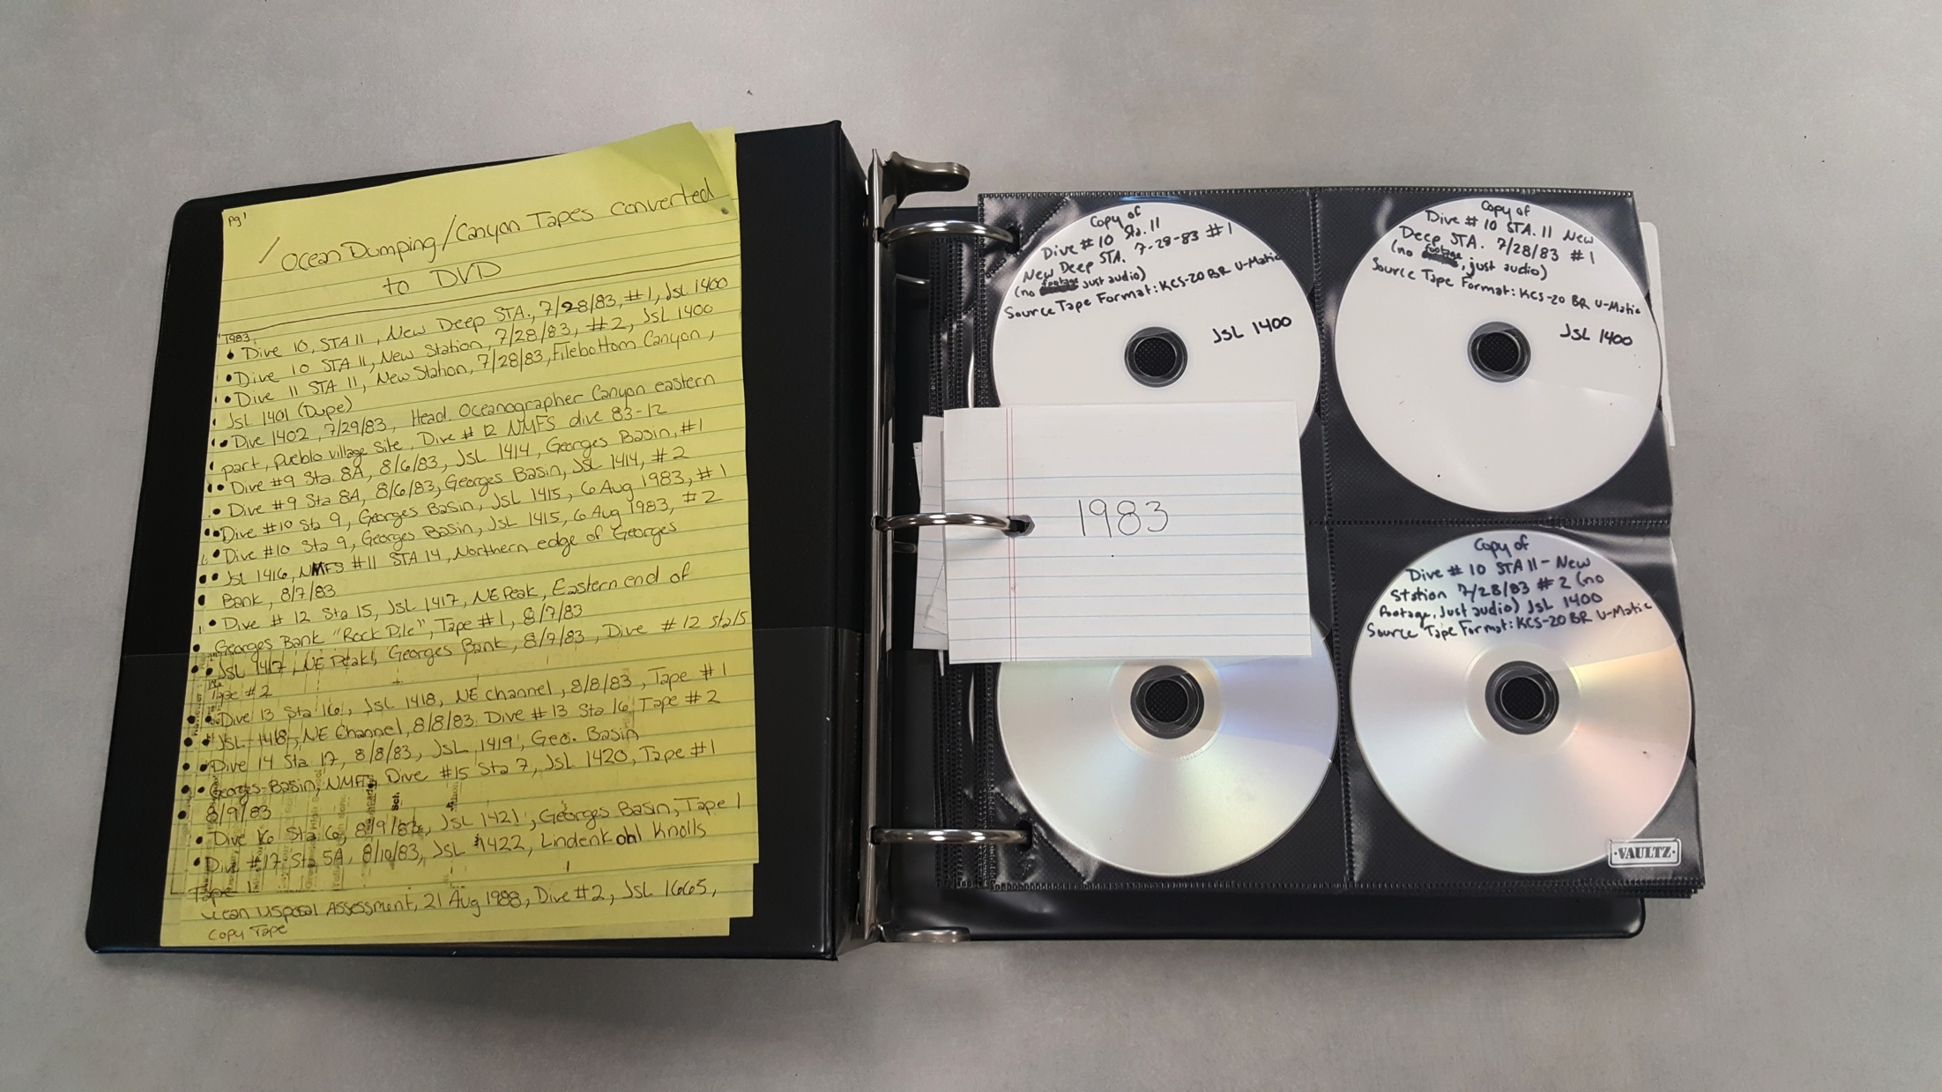
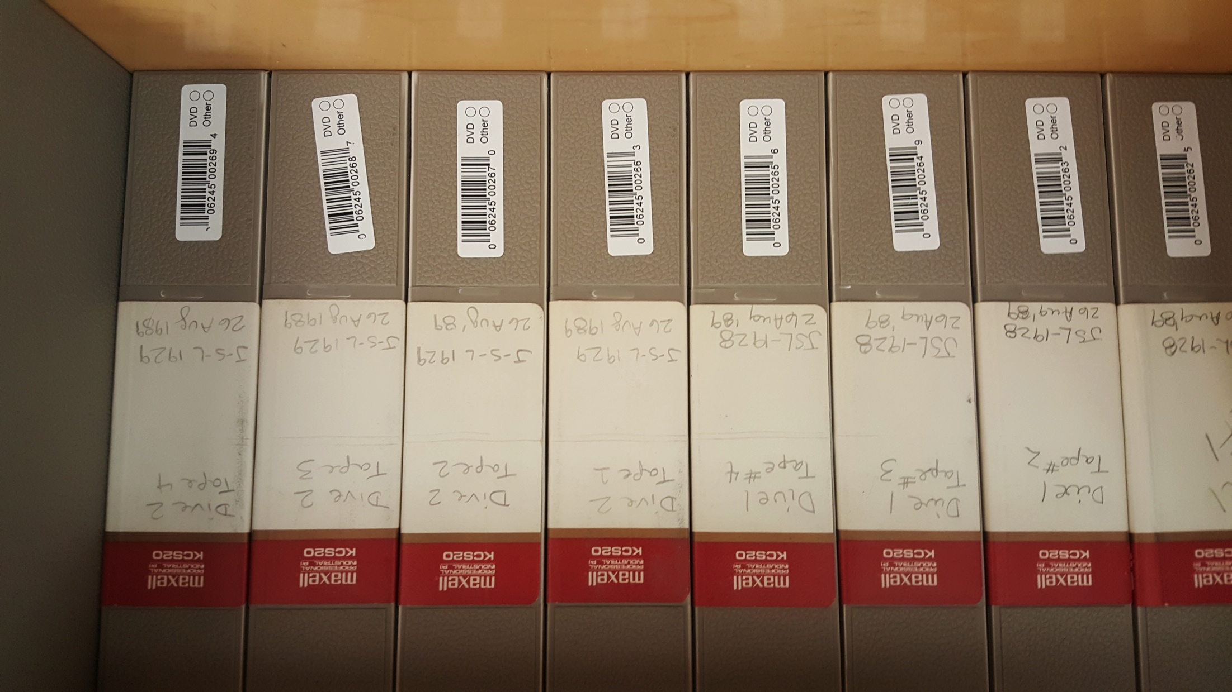
Data Rescue & Barcoding

Slide 6
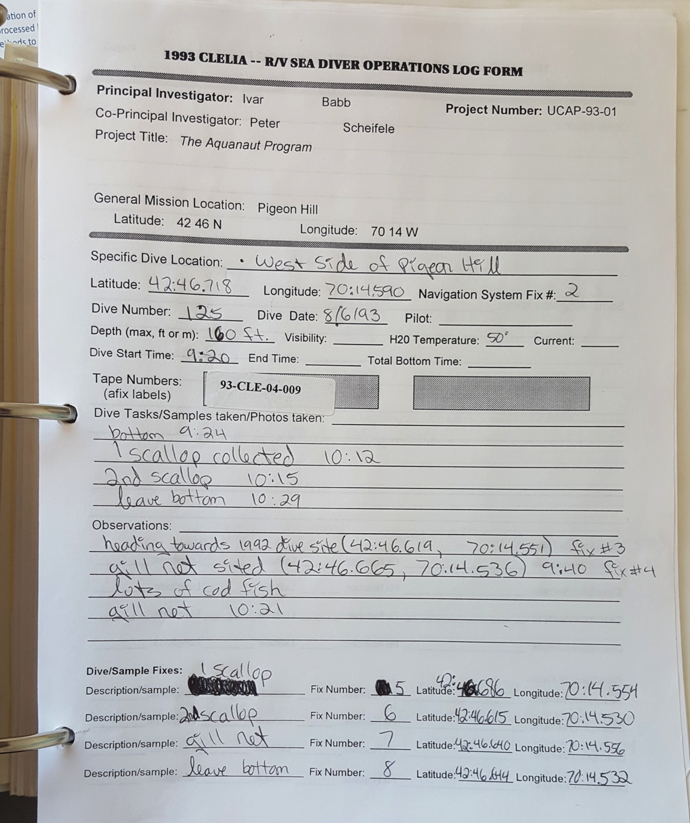
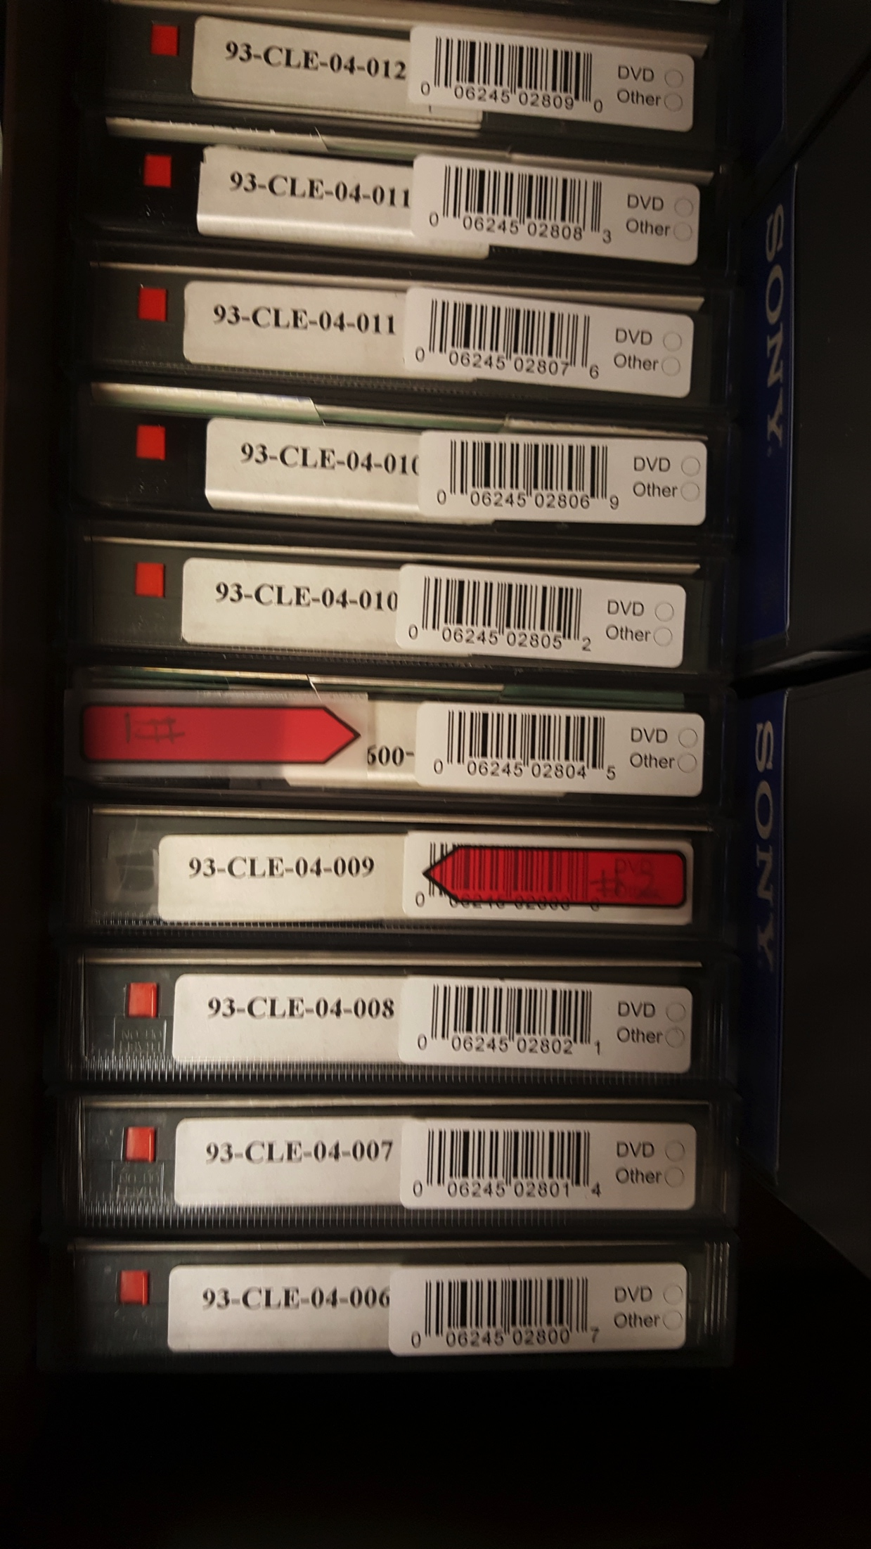
Project & Video Tracking

Slide 7
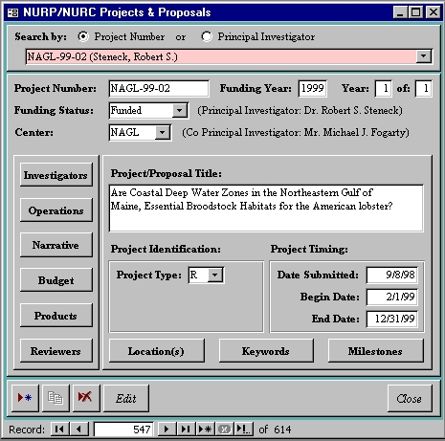
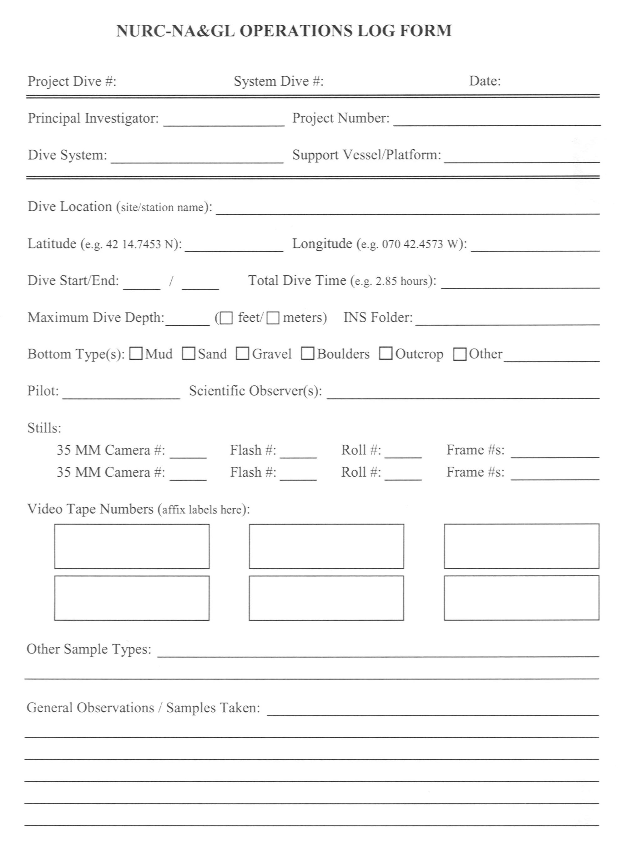
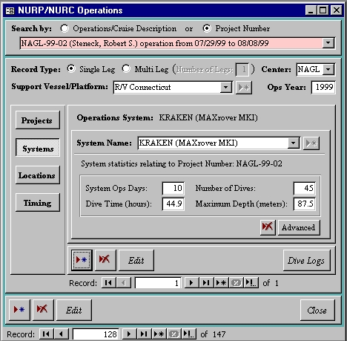
NURP MIS

Slide 8
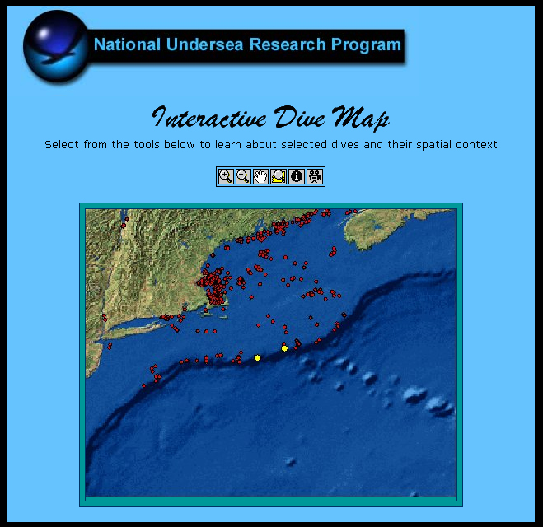
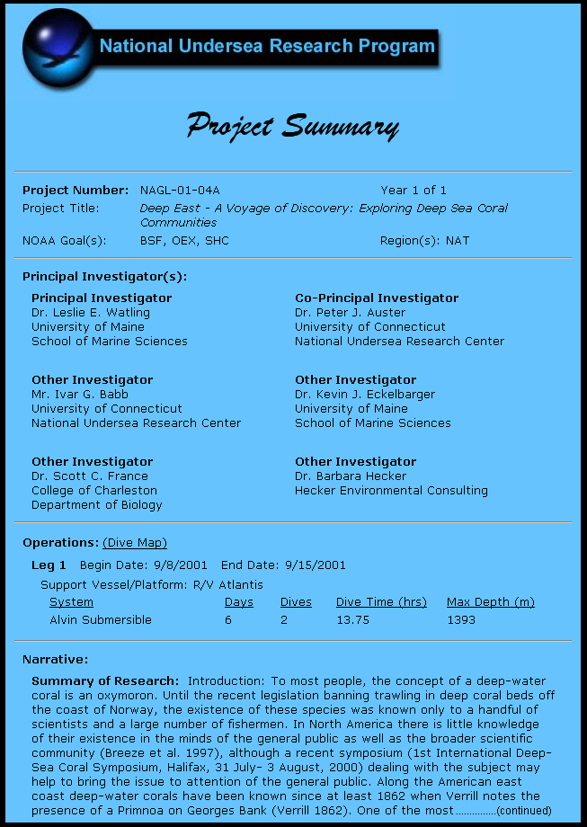
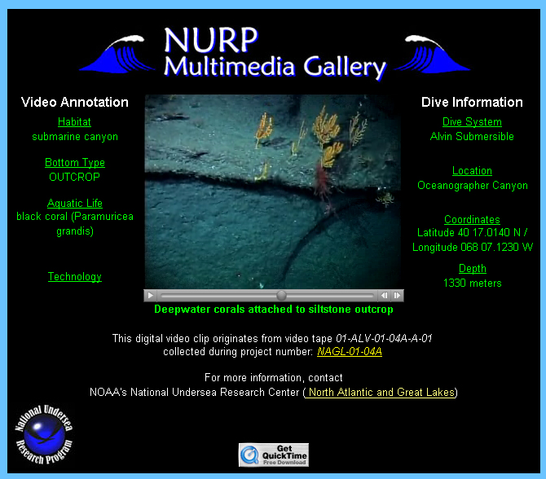
NURP MIS

Slide 9
Google Map Access

Slide 10
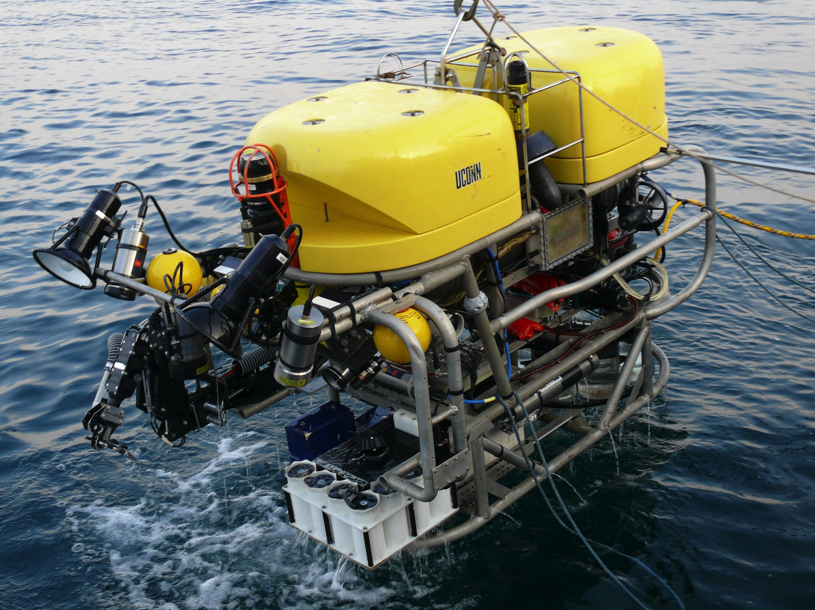
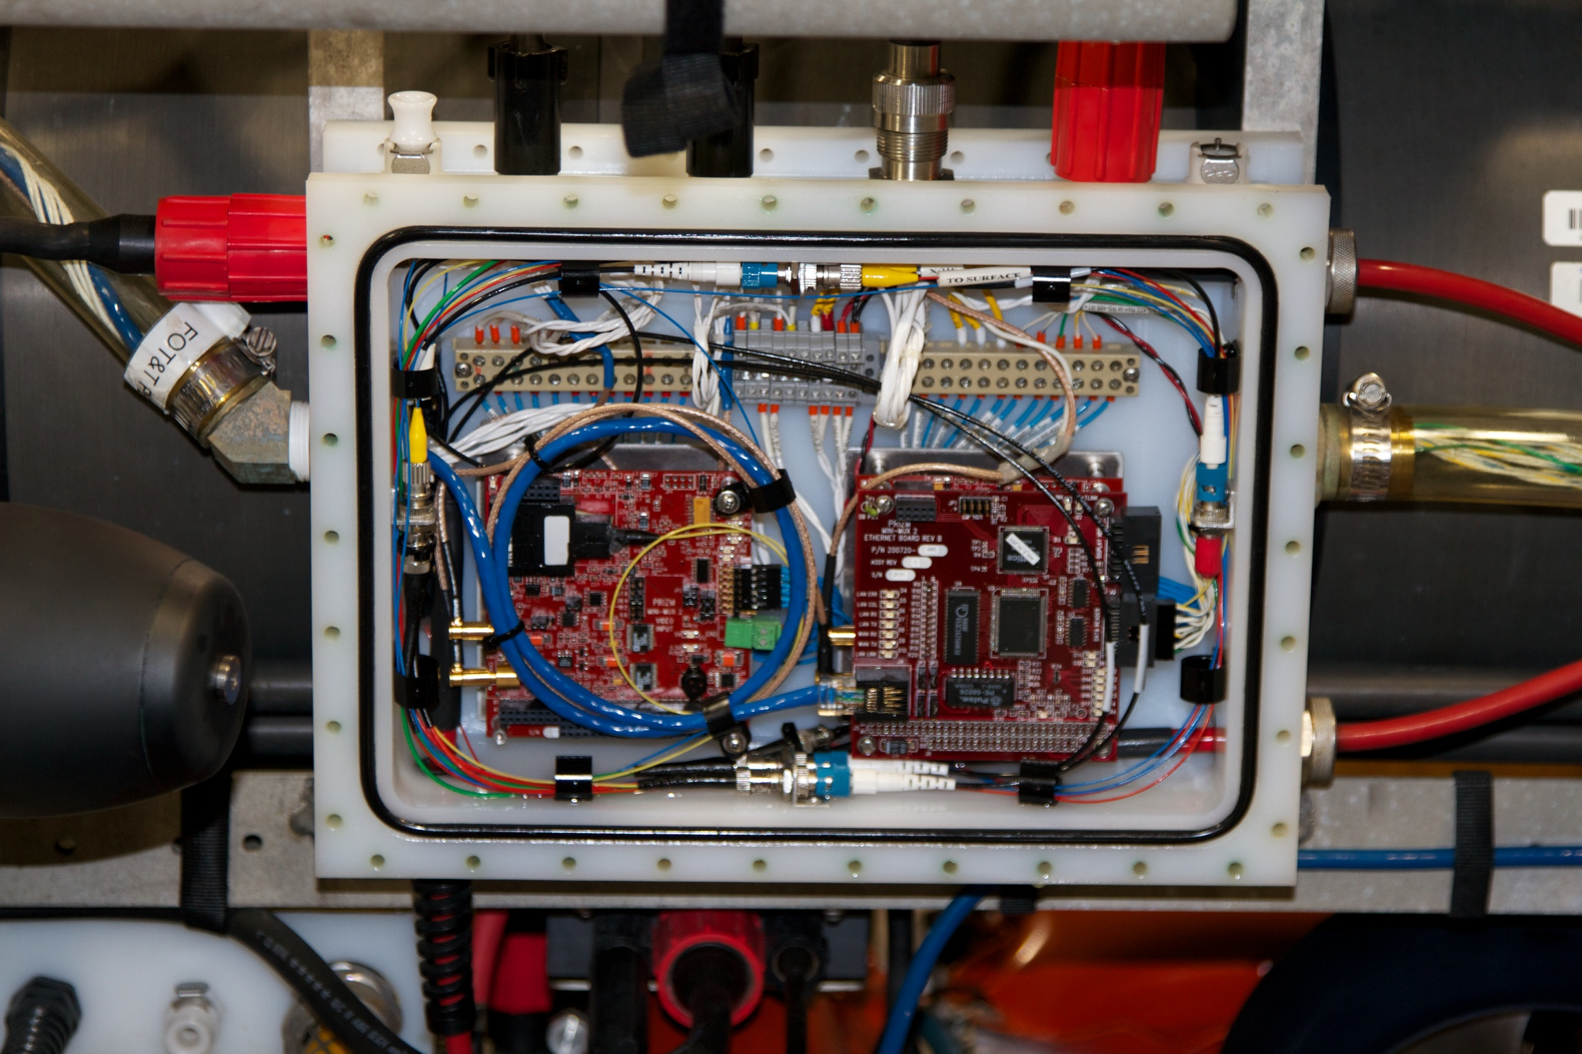
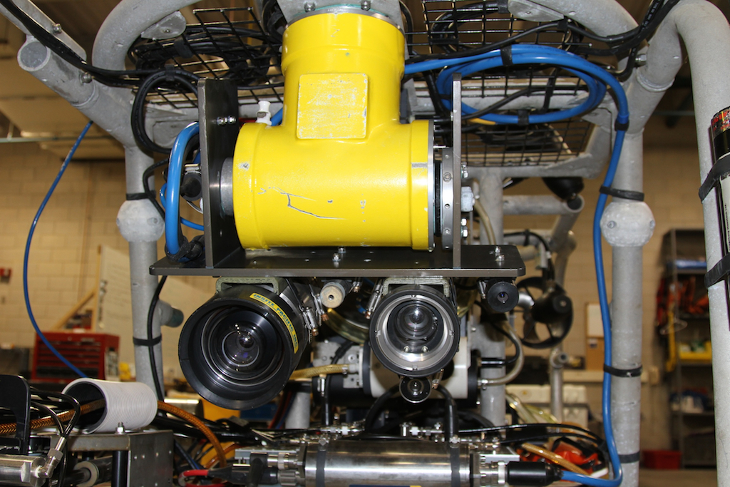
Current Video Workflow – Kraken2

Slide 11
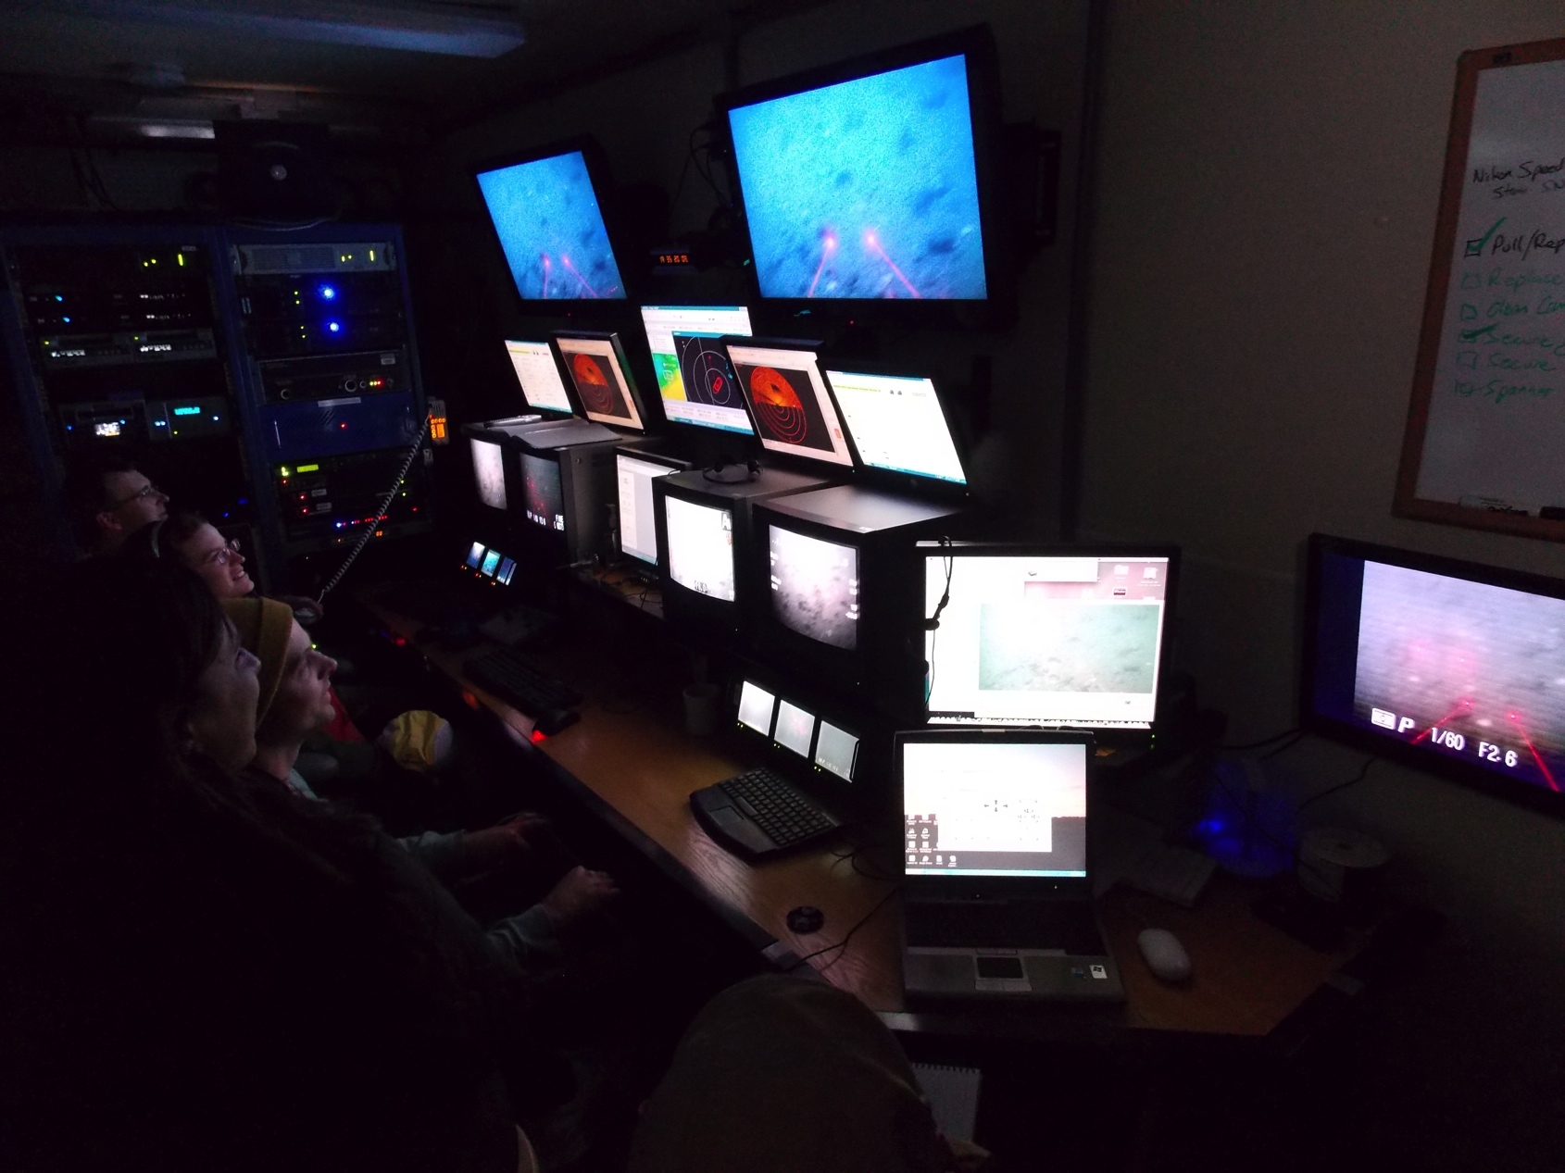
Current Work Flow – Control Van

Slide 12
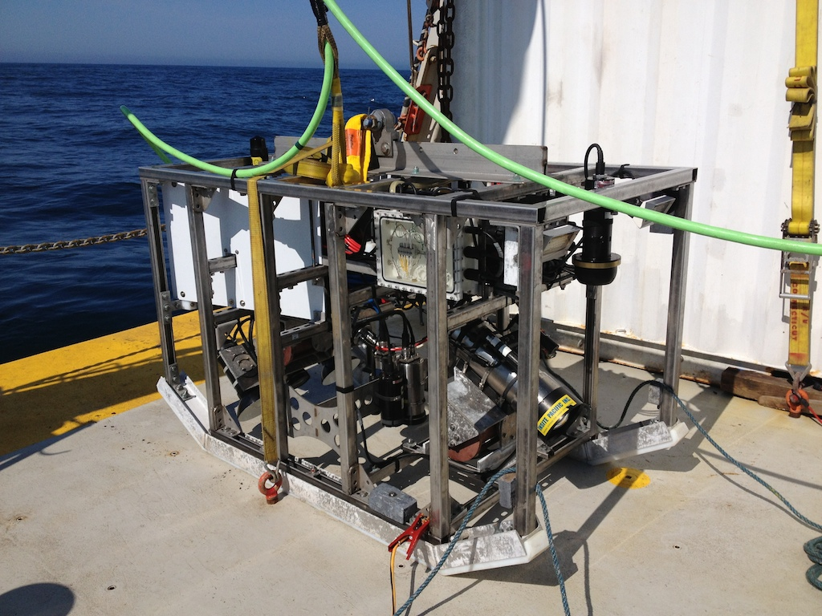
Current Video Workflow – ISIS2
Kongsberg HD Video
Kongsberg Digital Stills Camera
Insite Pacific Zeus Plus HD Video

Slide 13
Workflow – Encoding, Timecode, Storage

Slide 14
Workflow – Distribution
NURTEC is a UConn “Service Center” providing underwater technologies for various federal, state, academic and commercial clients, therefore video file naming is up the the client
Typically, video naming convention based on Project, by Dive #, with video clips saved every hour with automated file name increments – e.g. GOM Corals, Dive01-001, Dive02-002 etc.
Hard drives formatted as HFS+ and duplicated with an additional MacBook – Rocketstore setup
Down-converted video distributed on DVD
Video clips provided in Apple Pro-Res 422 HQ format as .mov files
NTFS for Mac software allows PC’s to read HFS formatted HDDs

Slide 15
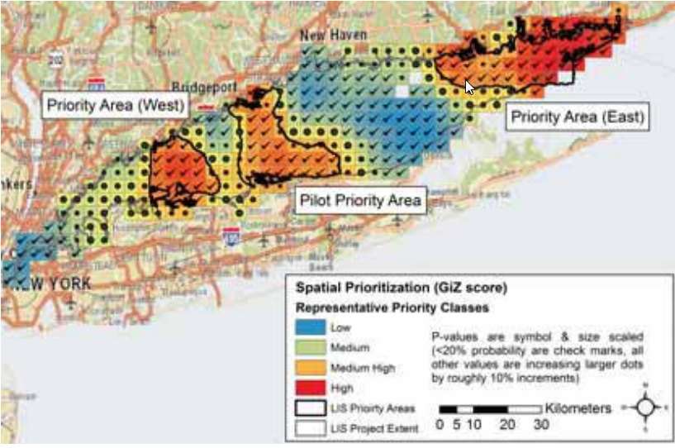








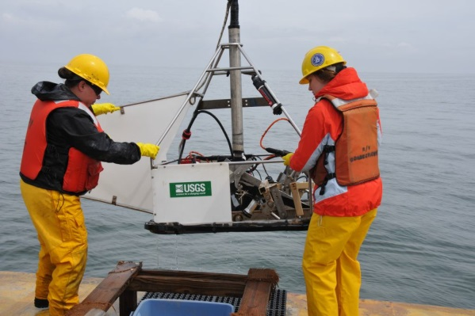
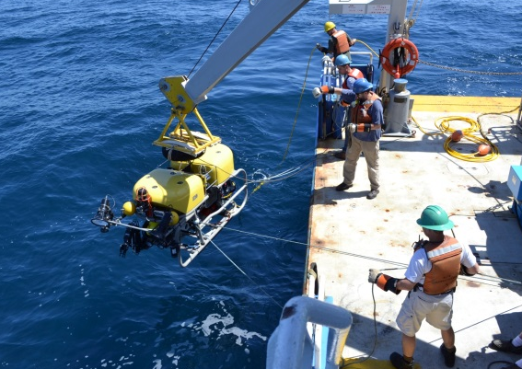
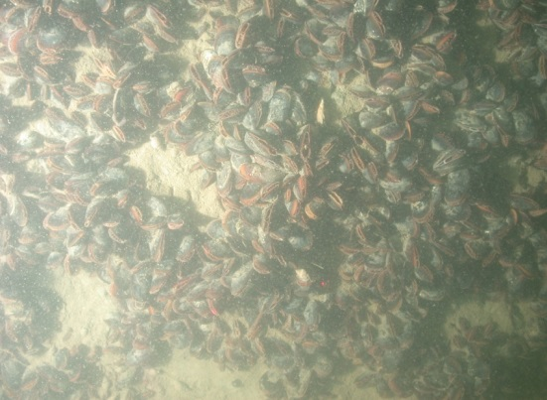
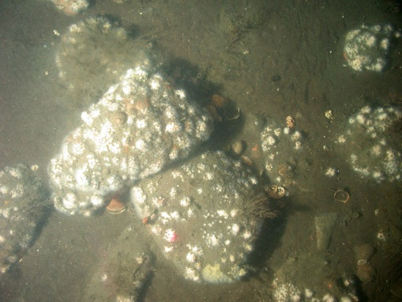
Video Access for LIS mapping – Evolving Standards
Notes:
The Long Island Sound Cable Fund is supporting a comprehensive habitat mapping initiative in Long Island Sound that is being conducted by federal, state and academic partners.
The effort began with a prioritization of areas in LIS to be mapped based upon management and research needs.
The Phase One Pilot Study has been completed in the Central Sound producing a broad range of data products including an integrated habitat map that combines acoustic, geological, ecological and physical data.
The data, assessments and products from the Cable Fund will also provide information for the Blue Plan and other efforts, particularly for subtidal nearshore and deeper waters.

Slide 16
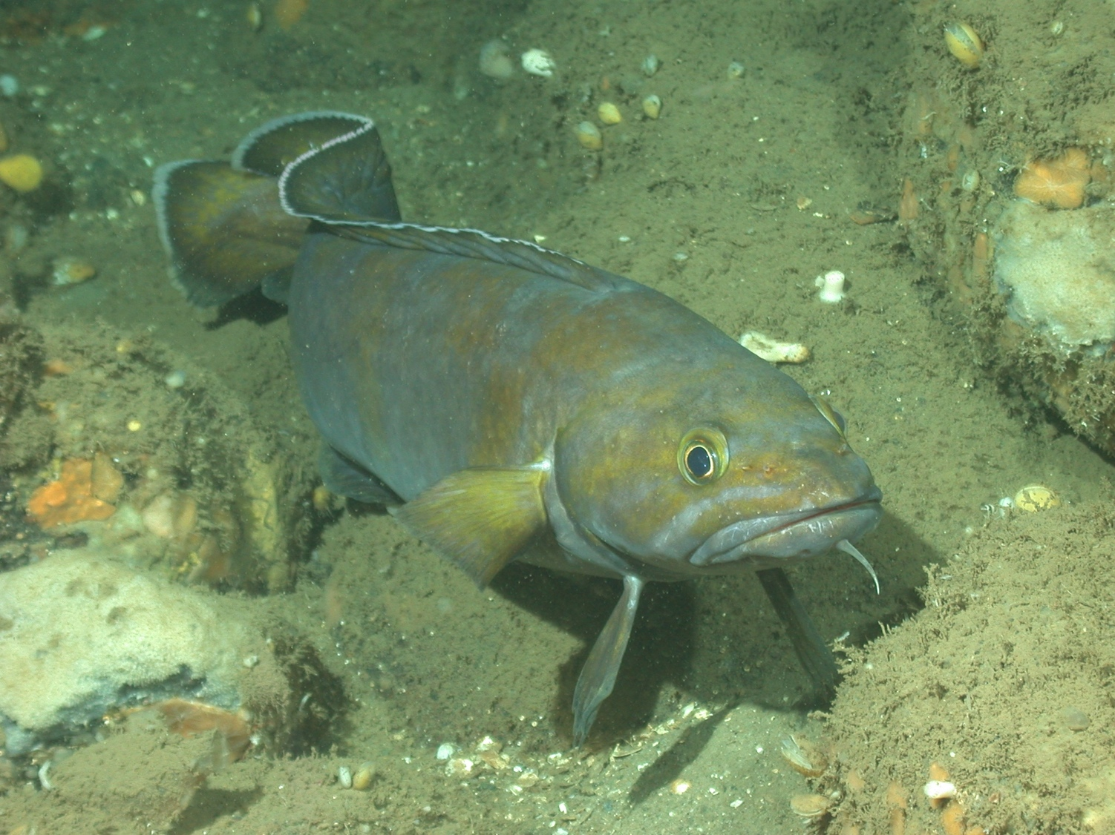

Questions??

Slide 17
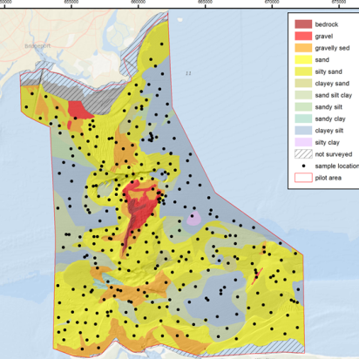
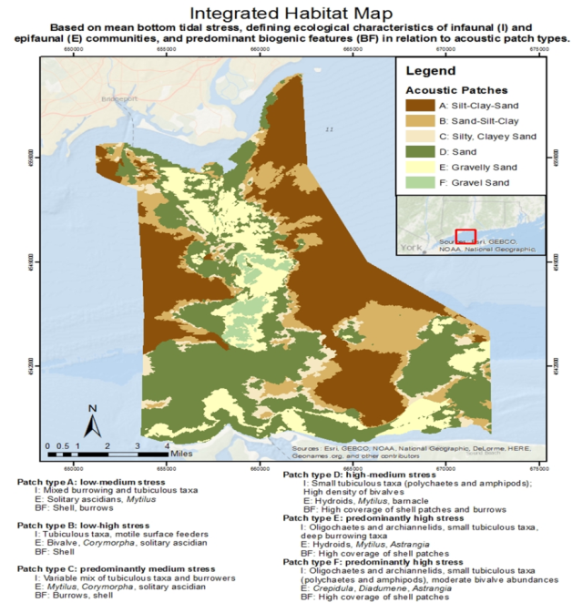
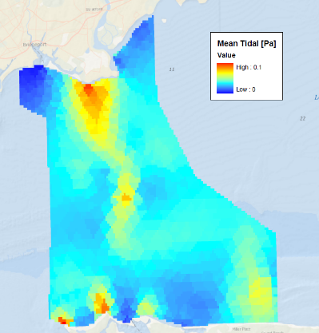
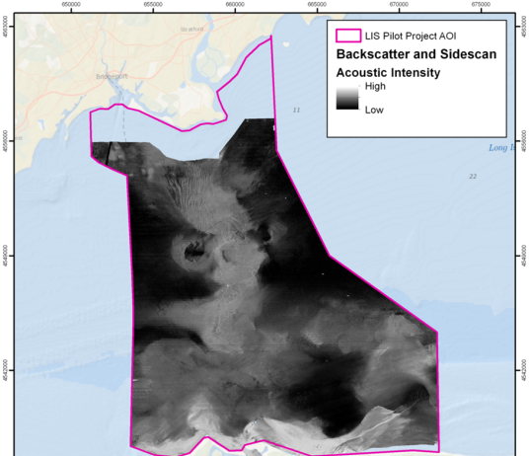
LISMaRC - Data Products to Aid Resource Management

